Slide 1
Knowledge representation
Week 11 & 12

Slide 2
What is Knowledge Representation?
Knowledge Representation in AI describes the representation of knowledge. Basically, it is a study of how the beliefs, intentions, and judgments of an intelligent agent can be expressed suitably for automated reasoning. One of the primary purposes of Knowledge Representation includes modeling intelligent behavior for an agent.

Slide 3
Types of Knowledge representation
Propositional logic
First order logic

Slide 4
Propositional Logic
Propositional logic, also known as sentential logic, is a language with some definite rules which deal with propositions and has no ambiguity in representation. It represents a conclusion based on various conditions and lays down some important communication rules. Also, it consists of precisely defined syntax and semantics which supports the sound inference. Each sentence can be translated into logics using syntax and semantics.

Slide 5
Advantages:
Logical representation helps to perform logical reasoning.
This representation is the basis for the programming languages.
Disadvantages:
Logical representations have some restrictions and are challenging to work with.
This technique may not be very natural, and inference may not be very efficient.

Slide 6
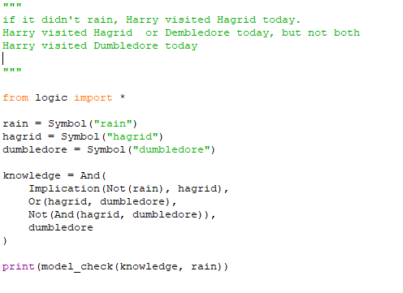
harry.py

Slide 7
First order Logic
First-Order Logic (FOL) is a logical way of allowing us to use statements to express relationships between things. It goes beyond fundamental logic by allowing us to talk about individual items by using variables and quantifiers. Based on what we already know, First-Order Logic helps us discover new knowledge or facts about a family. First-Order Logic is widely used in the field of Artificial Intelligence as a critical tool for tackling real-world issues.
A first-order logic knowledge base can only contain definite clauses. A definite clause is a clause with at most one positive literal, you can use parentheses to ensure that your clauses are definite.

Slide 8
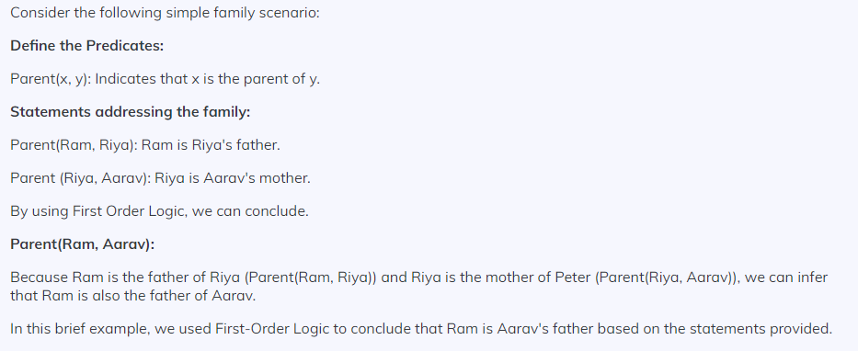

Slide 9
Syntax and Notations of First-Order Logic
Predicates
Predicates are symbols that represent the attributes or connections of things. They are used to construct assertions about things and their properties. For instance, "human(x)" may be a predicate indicating that "x is a human."
Variables
Variables are placeholders in logical statements that allow us to refer to undefined objects. They help in the creation of general statements that may be applied to any object. In the predicate "human(x)," for example, "x" is a variable that represents any human.
Constants
In First-Order Logic (FOL), a constant is a unique name of a certain item. It is like providing a label for the item in the logical statements.
Quantifiers
Quantifiers, namely universal () and existential (), allow us to make general statements about groups of items. The universal quantifier () means that a statement applies to all objects in the particular domain, whereas the existential quantifier denotes that there is at least one item in the particular domain.
Logical Connectives (AND, OR, NOT, IMPLIES )
Logical connectives are basic symbols in logic that are used to combine or transform simple statements to produce more sophisticated logical expressions. These connectives enable us to think about the links between propositions and serve as the foundation for logical arguments and expressions.

Slide 10
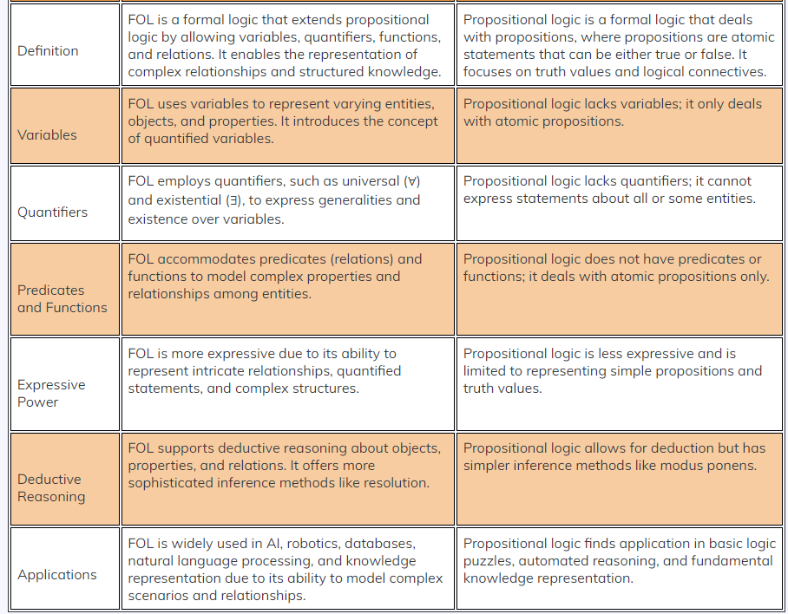

Slide 11
I am using code from aima-python in this tutorial (download package), these modules include all the necessary classes and functions for first-order logic in python. The knowledge base is created from the following sentence: The law says that it is a crime for an American to sell weapons to hostile nations. The country Nono, an enemy of America, has some missiles, and all of its missiles were sold to it by Colonel West, who is American.

Slide 12
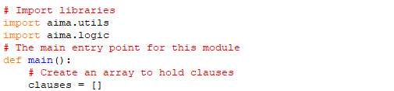
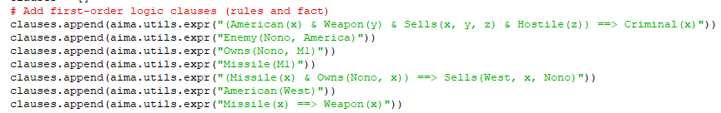

Slide 13
Forward Chaining
A forward chaining algorithm looks at each rule in the knowledge base to see if the goal can be satisfied. This algorithm uses unification to form new sentences, new sentences are added to the knowledge base and this process is repeated until the question can be answered or until no more sentences can be added. A query can have multiple answers with forward chaining.

Slide 14
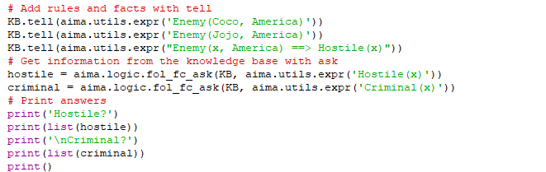

Slide 15
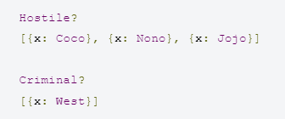
output

Slide 16
Backward Chaining
A backward chaining algorithm starts from the goal and chains through rules to find facts that support the goal. This backward algorithm will only find the first fact that supports the goal, even if it exists multiple answers in the knowledge base.

Slide 17
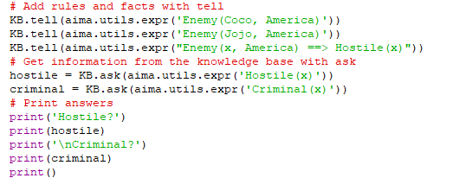

Slide 18
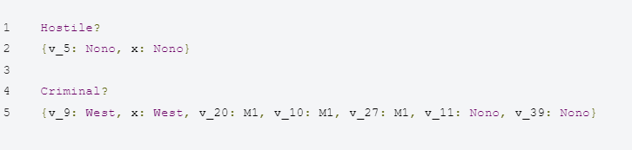
OUTPUT

Slide 19
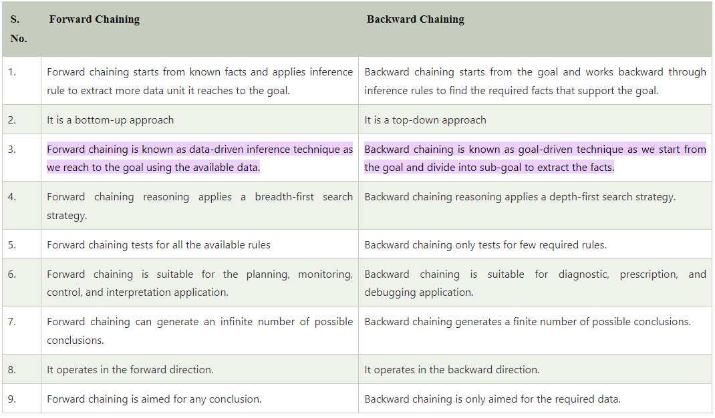

Slide 20
References
https://github.com/aimacode/aima-python
https://www.annytab.com/first-order-logic-in-python/
https://www.javatpoint.com/difference-between-backward-chaining-and-forward-chaining#:~:text=Forward%20chaining%20is%20known%20as%20data%2Ddriven%20inference%20technique%20as,goal%20to%20extract%20the%20facts.
http://www.sista.arizona.edu/~clayton/courses/ai/projects/wumpus/docs/logic.html
https://notebook.community/SnShine/aima-python/logic
https://www.youtube.com/watch?v=mkr1nmQJQ_E&list=PL1JaO4n1WBl7pd04M17Xlaip8Krsdt_MT&index=1

